Slide 1
API Manufacturing Site Guayama, Puerto Rico
“ Skalar Pharma a Puerto Rico-based API Manufacture
that can supply all of your API needs ”

Slide 2
Skalar Pharma
At Skalar Pharma, we offer:
A diverse range of manufacturing and contract manufacturing services for the active pharmaceutical ingredients (API’S) industry
Focus on exceptional quality and safety standards that meet strict regulatory guidelines, such as cGMP
Production of high-quality API products
Formulation development, and analytical testing as a contract manufacturer to support your product development process
Commitment to sustainability and environmental responsibility in our manufacturing processes and product offerings
Partner with Skalar Pharma to deliver top-quality, safe, and sustainable products to your customers.

Slide 3
Strategic Statement
OUR MISSION
We will produce high-quality active pharmaceutical ingredients that will surpass the requirements of pharmaceutical manufacturers. As a result, our clients will reward us for our leadership by increasing our sales, profits, and value creation, which will benefit our employees, shareholders, and the communities where we live and work.

Slide 4
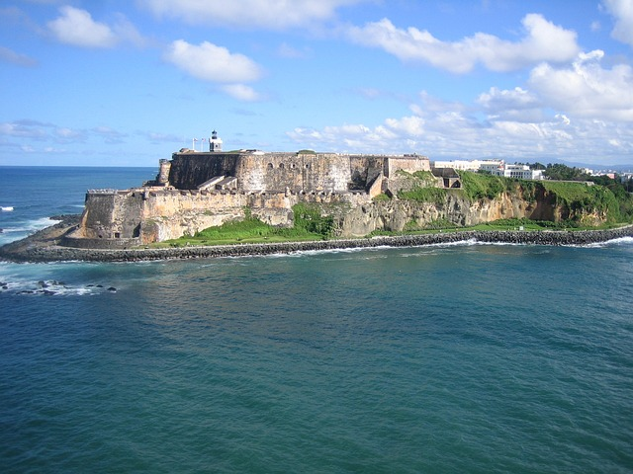
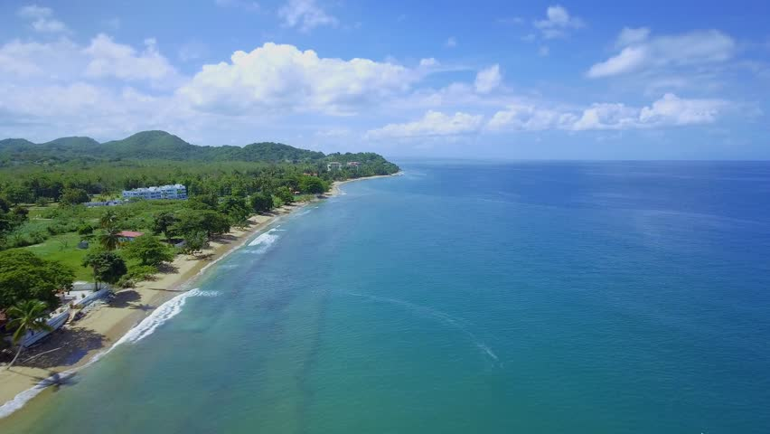
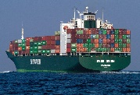
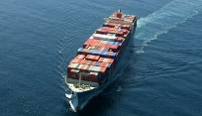
Puerto Rico –US Territory
Site Location

Slide 5
Site Profile
Location
30 miles from Ponce
60 miles from San Juan metro area
Easy highway access
Close to port, hospitals, and fire departments
100-acre property, 35 acres currently developed
History
Initial facilities commissioned in 1992
Site purchased by Lilly in 2005 from AstraZeneca
Site purchased by Skalar Pharma LLC in 2016 from Lilly
Workforce
Current staffing is 50 employees
Highly trained personnel in the pharma and chemical industry
Engineers and chemists with over 20 years of experience in API manufacturing
Production Facilities
3 production buildings suitable for API production at large scale (1000-2000 gallons)
1 production building suitable for API production at a small scale (150 gallons)
1 production building with micronization capabilities
Other Facilities
Utilities with wastewater treatment plant
Warehouse and dispensing building
Anhydrous HCl handling system
Solvent tank farm
Solvent recovery
Laboratory and technical support building
Maintenance building
Administration building
Parking and cafeteria
10-acre nature reserve
Wellness Center (Gym)
Warehouse, 500 pallet space, capable of handling-controlled substances
5

Slide 6
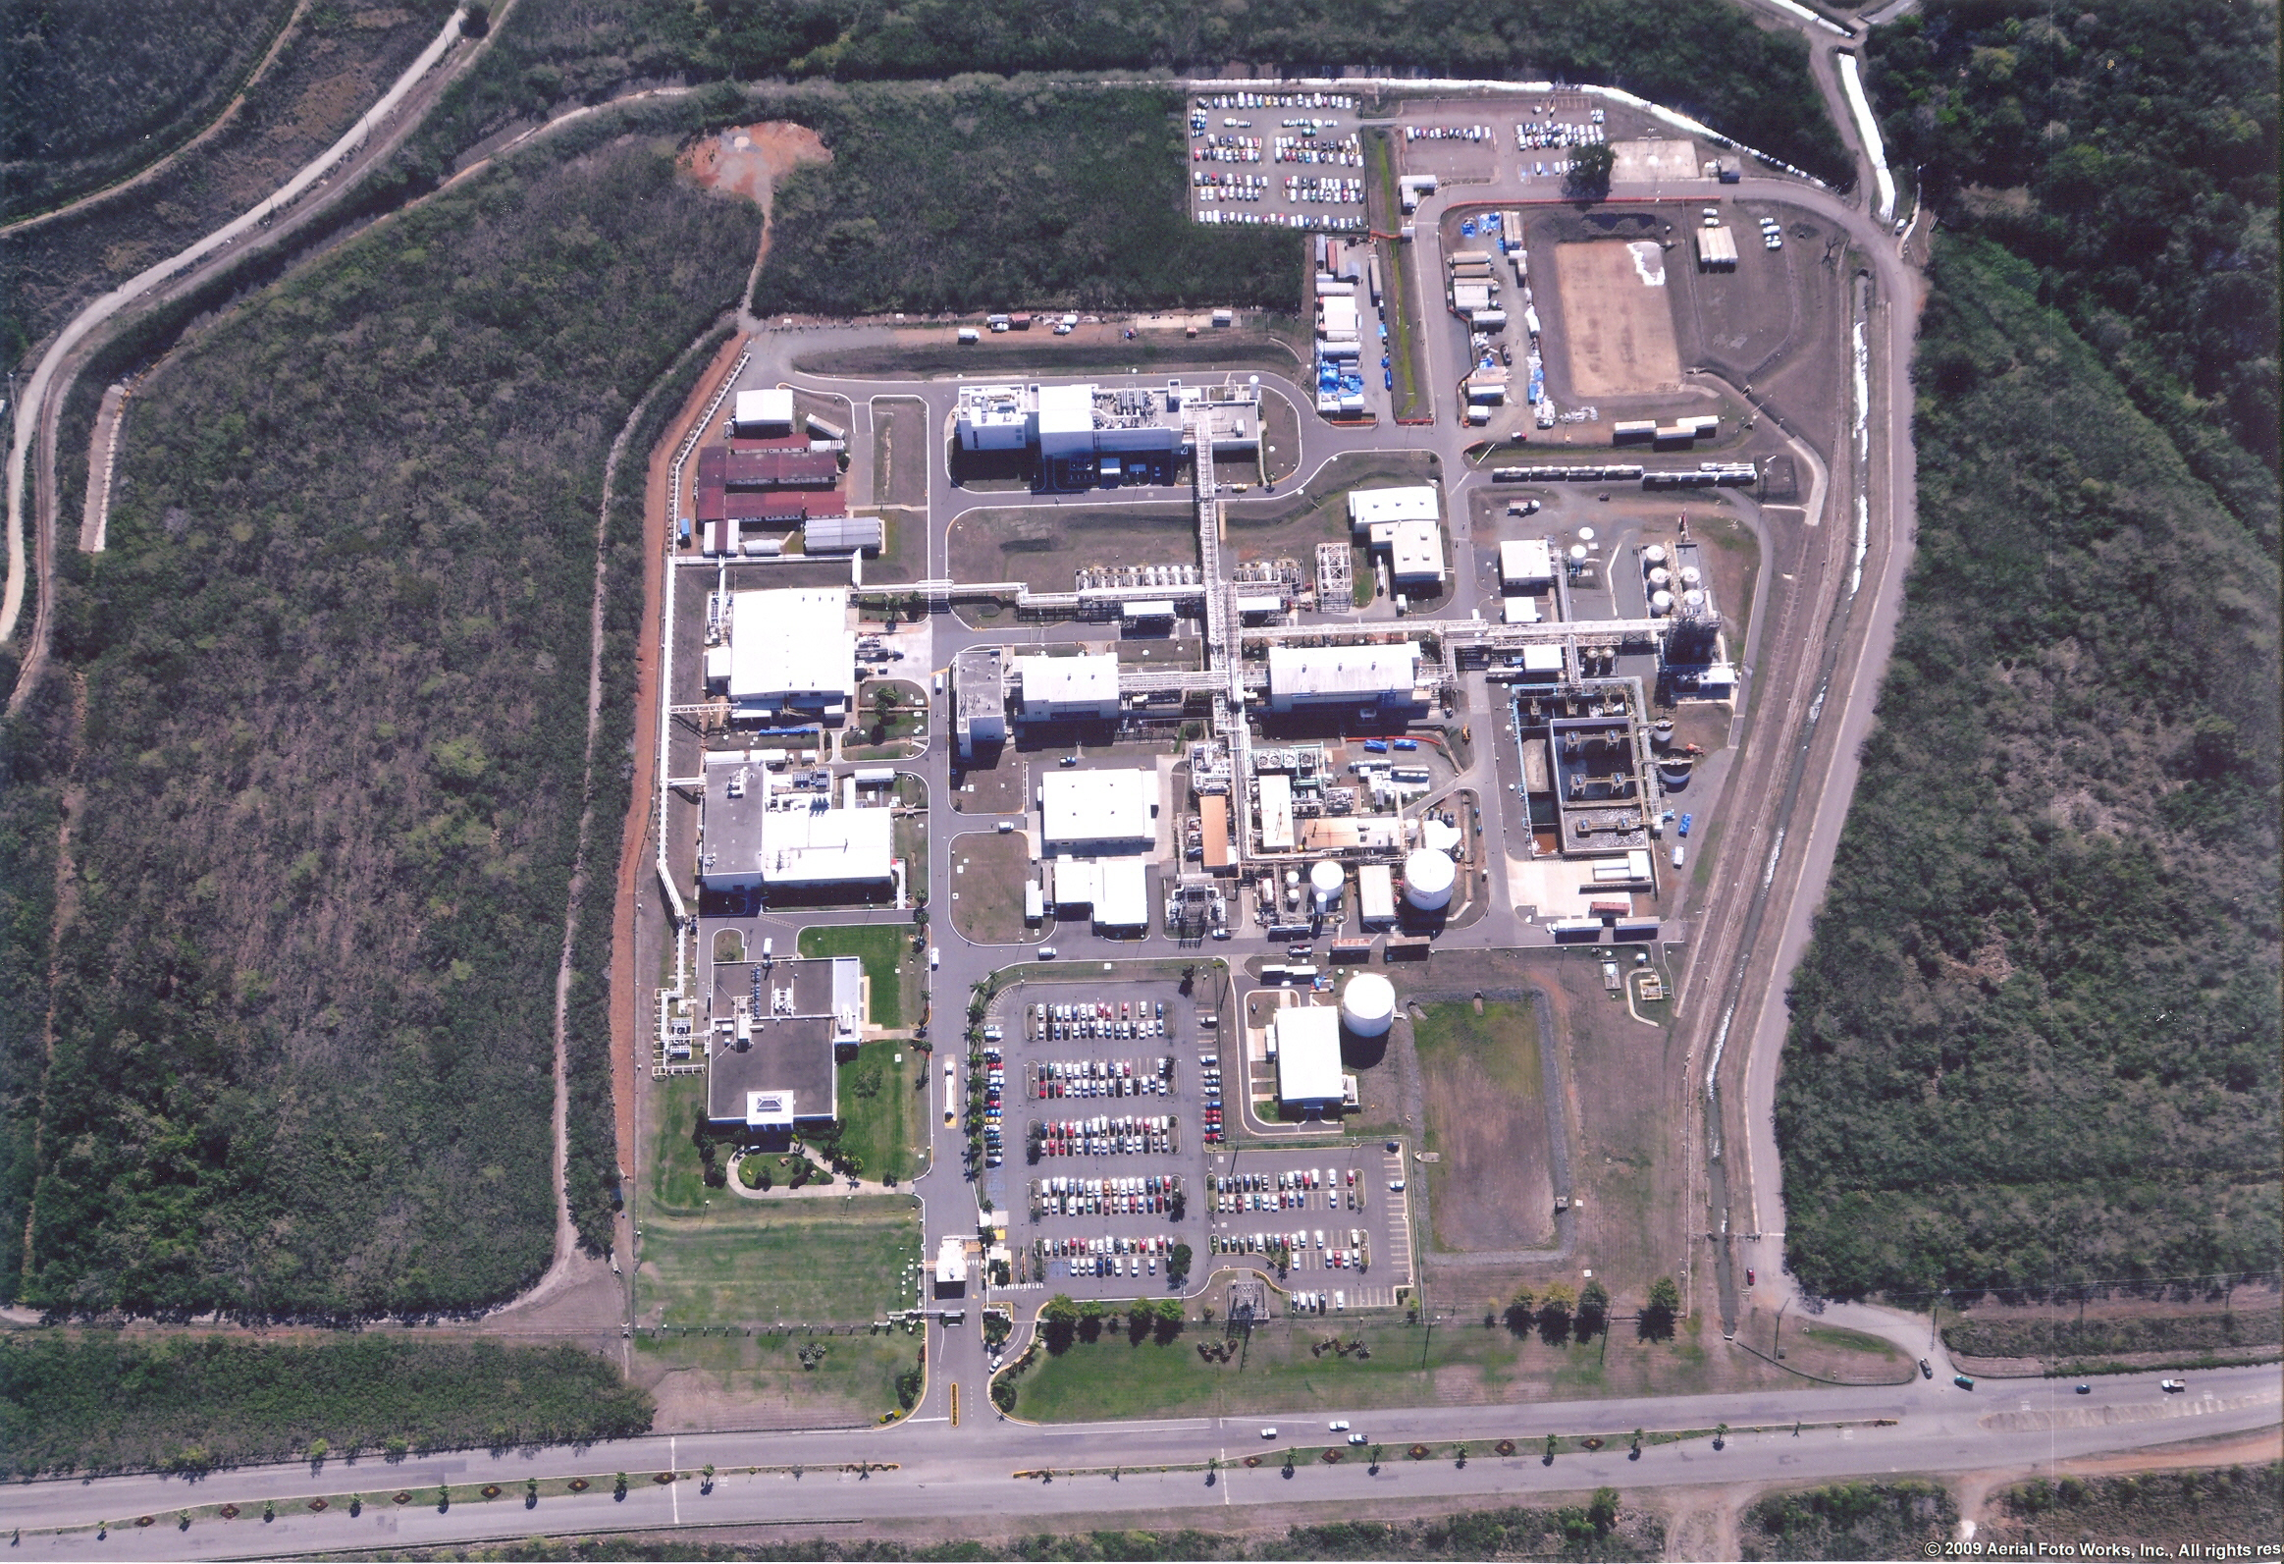
Bldg. 25
Bldg. 24
Haz Mat Warehouse
Tank Farm
Solvent Recovery
Warehouse
Bldg. 22
Bldg. 21
Bldg. 23
QA
Maintenance
Wastewater Treatment
Utilities
Wellness Center
Admin

Slide 7
Production Equipment List
Building 21
3 Glass-lined reactors 4,000 liters
1 Glass-lined receiver 6,000 liters
1 Glass-lined receiver 2,500 liters
1 Heinkel HF-600 SS316 centrifuge
1 SS316 plate dryer
Building 22
2 Glass-lined reactors 500 liters
1 Glass lined receiver 850 liters
1 Heinkel HF-450 SS316 centrifuge
1 SS316 cone dryer 200 liters
1 SS316 Bauermeister UT-03 pin mill
Liquid & solids charging booth
Highly contained facility
Building 25
1 Sturtevant spiral jet mill, 12-inch (Micronizer)
Building 23
4 Glass-lined reactors 6,000 liters
1 Glass-lined reactor 10,000 liters
2 Glass-lined receivers 4,000 liters
1 Glass-lined receiver 7,500 liters
1 SS316 receiver 15,000 liters
1 Hastelloy filter dryer, 3 m² area
Purified water generation system
1 receiver (SS316) of 15,000 liters for purified water
Building 24
1 Hastelloy reactor 7,500 liters
3 Glass-lined reactors 7,500 liters
3 Glass-lined reactors 6,000 liters
1 Glass-lined reactor 4,000 liters
2 Hastelloy filter dryers, 3 m² area
Solid Charging/Discharging Enclosed Areas
Solvent Recovery
3 distillation columns
5 storage tanks 136,000 liters
7

Slide 8
Production Capabilities
Currently Installed Capabilities & Unit Ops
Small to large-scale manufacturing
High potency compounds
Controlled substances
Chiral synthesis
Hazardous reactions
Hydrogenation
Moisture Sensitive Chemistry
Palladium Mediated Reactions
Particle size reduction (On-Site Milling and Micronization)
Processes based on renewal energy input – New solar panel farm
Highly automated facility – Delta V control
Potential Capabilities
Cryogenic temperatures
Cytotoxic-capable reaction vessels
New Solar Panel Farm
8

Slide 9
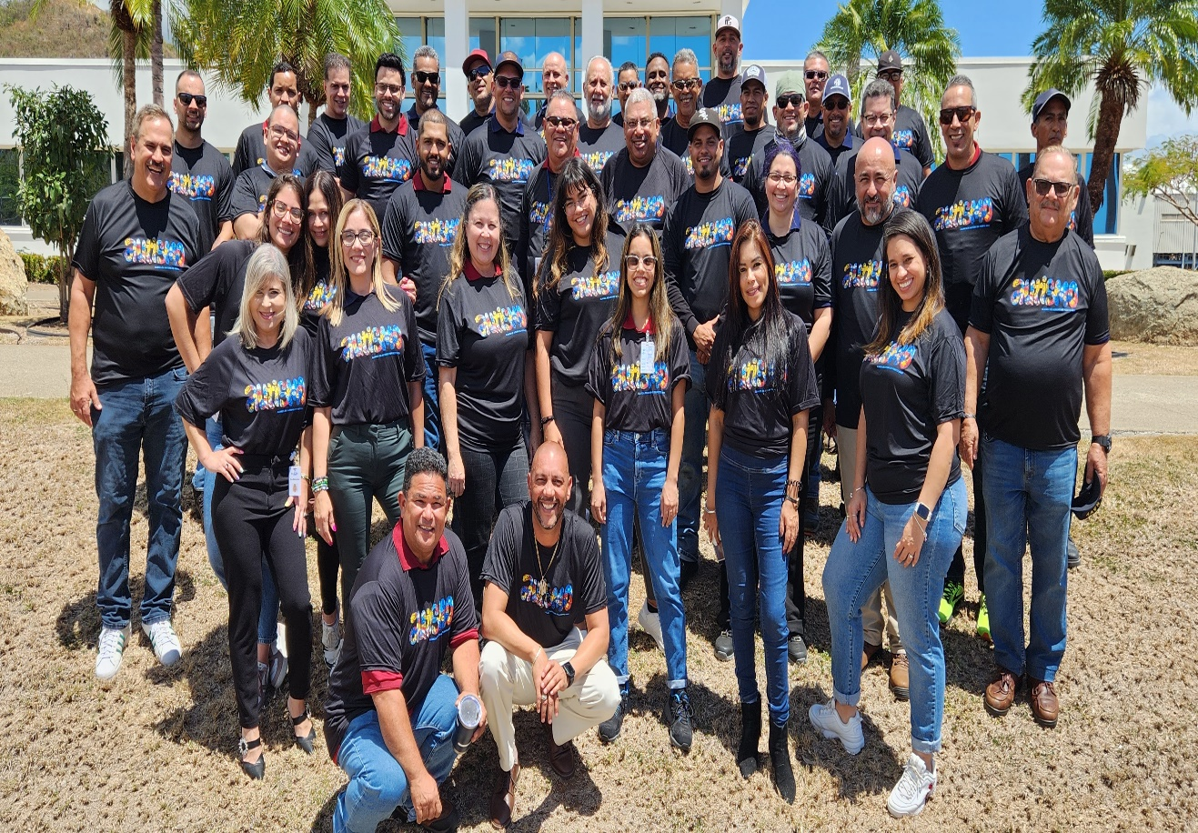
Our People
Strong team of highly trained personnel in the pharmaceutical and chemical industries, with a significant percentage of engineers and chemists who have extensive experience in API manufacturing.
Current staffing is > 50 employees.
Engineers and chemists with over 20 years of experience in API manufacturing
16% of our staff has postgraduate degrees (Ph.D. or M.S.).
35% are Engineer/Chemist
65% are supporting personnel (mechanics and technicians).
9

Slide 10
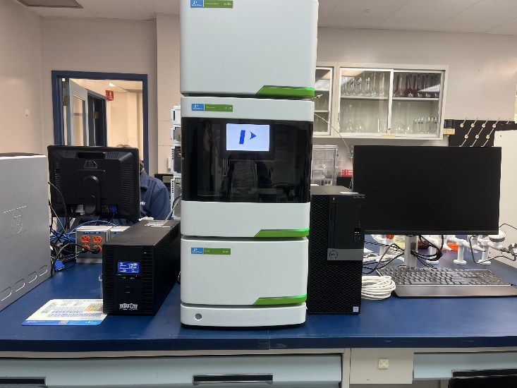
Laboratory Capabilities
Analytical Labs
10,500 square ft of analytical labs
Three main labs: Bench/Kilo Lab, In-Process/Raw Material, and Final Labs
Fully equipped with all principal analytical technologies and several specialties
Areas with security controls capable of handling-controlled substances
Several stability chambers fitted for multiple conditions (40/60/75% RH)
Process Development Labs
Lab scale reactors bench and kilo from 0.5 to 10 L
Specialty analytical equipment such as HPLC, GC-MS, GC-FID-TCD, IR, Particle size, ICP MS, Nitrogen generator, Karl fisher, Polarimeter, Melting point
10

Slide 11
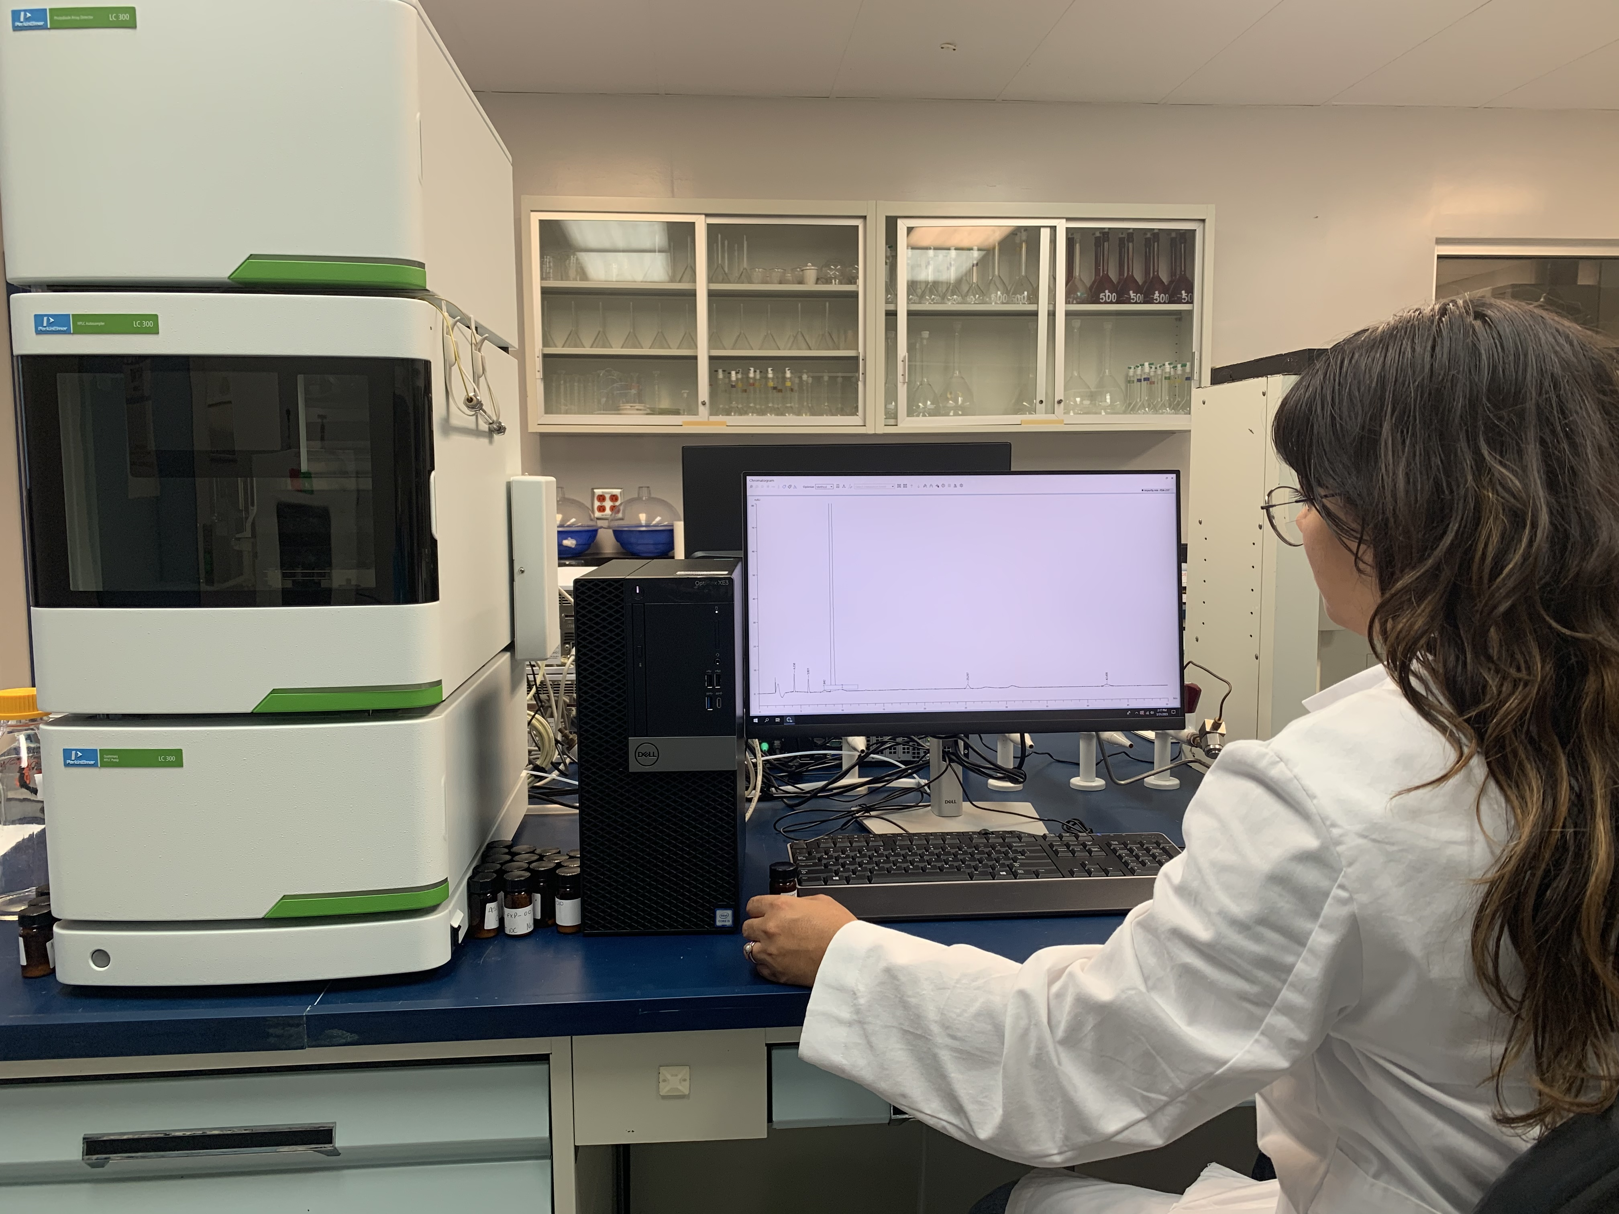
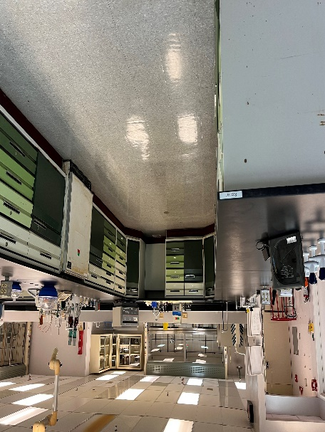
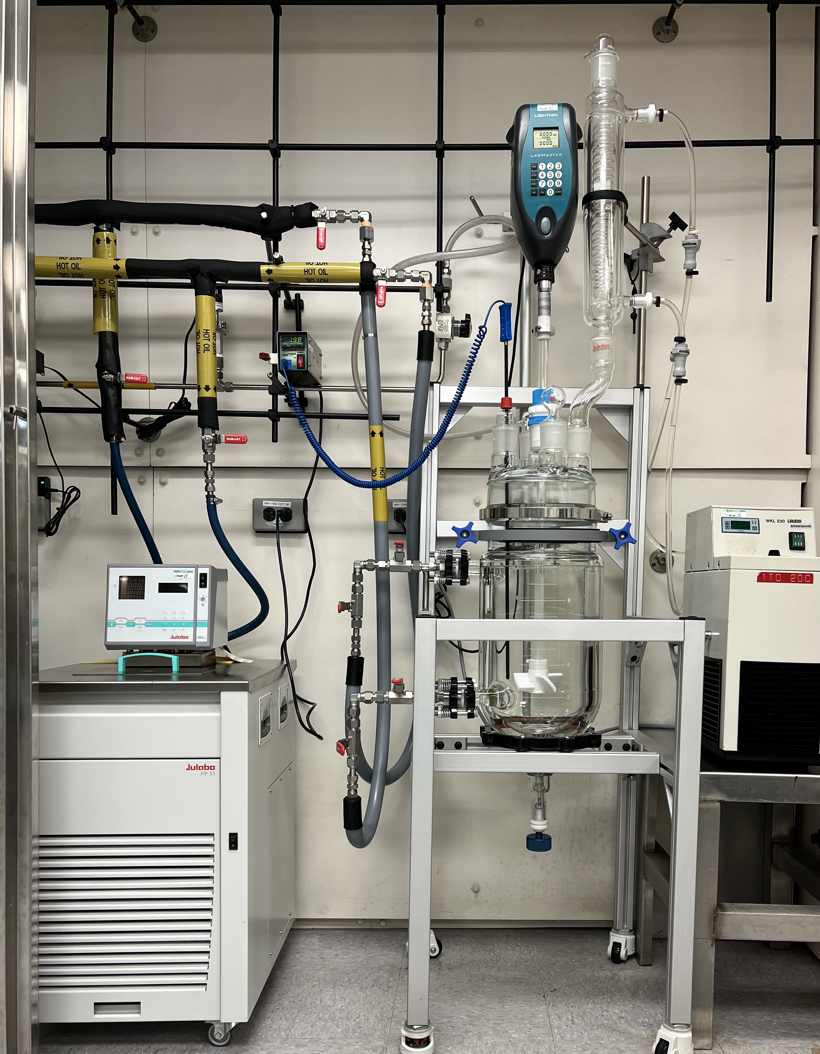
Laboratory Capabilities
Raw Material and Production Process Laboratory
HPLC, GC, KF
R&D, Process Development
Bench and Kilo
0.5 to 10 L Reactors
Quality Control
Laboratory GMP
Designed
Final Product and Stability
HPLC,GC, PSA, FTIR-
Microbiology
CFL, Incubators,
Refrigerator, Autoclave
Consulting and Support
Stability Chambers and Rooms, Supplies Storage, Material Cleaning, Data Analysis, Fitting Rooms

Slide 12
Utilities
Tank Farm
7 Solvent tanks and 4 liquid waste tanks, each 45,000 liters
Glycol System
1 chiller with anhydrous ammonia, 2,500 lbs. (-21 C Glycol Generation)
Steam
Two 125 psig boilers, one of 200 HP and another of 400 HP
Chilled Water
Two chillers with 1000 tons of process and facilities refrigeration capacity
Purified Water
Two independent purified water generation systems with a total capacity of 800 gal/hr.
Fire Suppression Water
1,000,000 gallons of Fire Water Capacity
Instrument and Plant Air
Three air compressors, one back-up
Electricity
Supplied by PREPA (Puerto Rico Electric Power Authority), the site has two backup generators
12

Slide 13
Wastewater Treatment / Environmental Capabilities
1.5 million gallons wastewater treatment plant
12 GPM solvent recovery facilities
Steam stripper to remove volatile organic compounds from wastewater
Ozone oxidation unit, capable of destroying organic molecules
13 sampling wells across the facility to monitor for groundwater contamination
13

Slide 14
Site Permits & Inspections
Environmental Permits:
Minor Source Permit (Air Emissions)
RCRA Small Quantity Generator Permit
EQB Used Oil Generation/Disposal Permit
NSPS/PSD Boiler No. 3 Permit
OGPe Use Permits
Licenses:
Fire Department License
Health Department License
Explosive Handling License
Pressure Vessels/Elevator Licenses from Labor Department
Property and Building Risk Insurance
14

